Slide 1
Classifying and Searching News
Articles from Key Phrases
Mehmet Acikgoz, Irfan Ahmed, Jonathan Wolfe

Slide 2
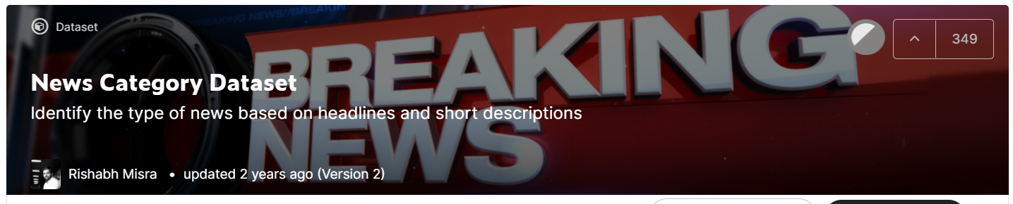

Dataset
{ category: Category article belongs to
headline: Headline of the article
authors: Person authored the article
link: Link to the post
short_description: Short description of the article
date: Date the article was published
}

Slide 3
Data Preparation
Data Sampling
The dataset has over 200K records
Imbalanced dataset
Keywords Extraction
Web scraping
Several algorithms available (TF-IDF, TextRank, and Rake)
We used Rake algorithm.

Slide 4
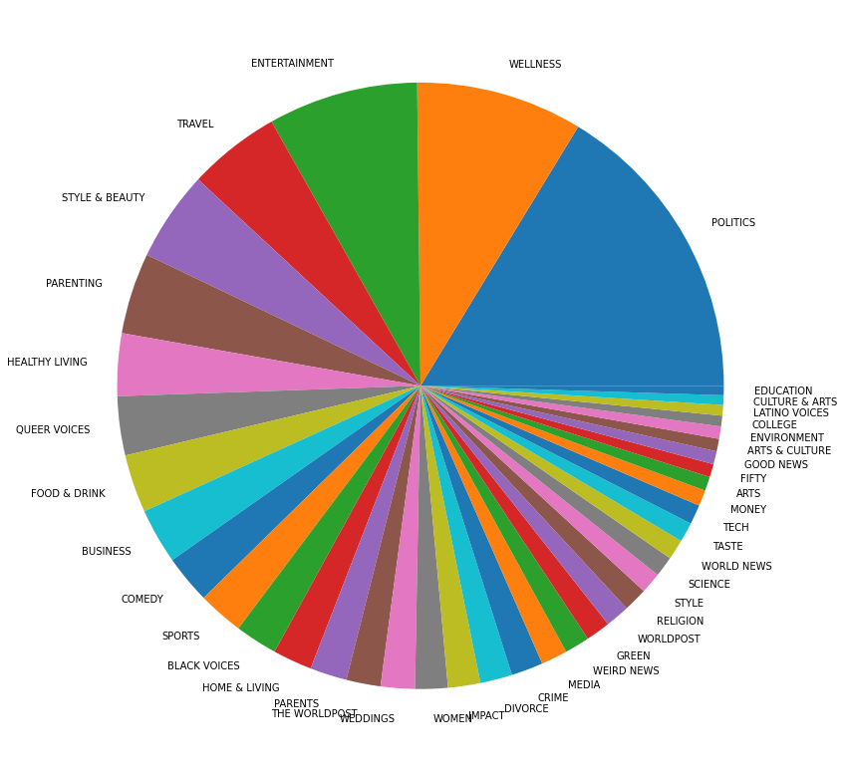
Data Sampling
The original dataset has more than 200K records.
It is time-consuming to use all all the dataset
There are 42 categories available in the dataset
Imbalanced data

Slide 5
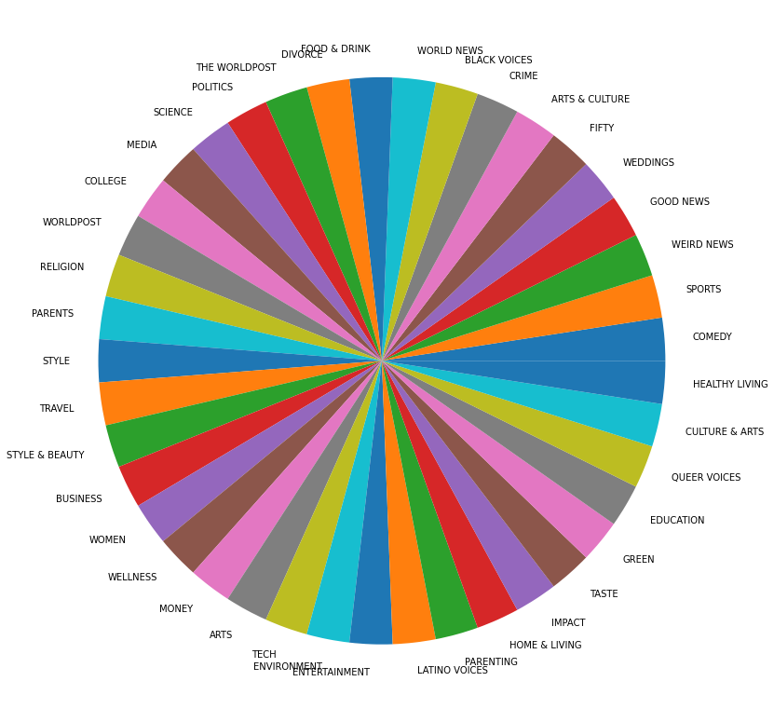
Data Sampling
Sampling around 500 records for each category
Randomly selected records
Using sample dataset is practically easy
Balanced data

Slide 6

Web Scraping
We used the link of each article to get the main text.
Ignore the non-ascii characters in the articles and some punctuation characters

Slide 7
Keywords Extraction
Several libraries are available for keywords extraction.
TF-IDF:
Text Frequency Inverse Document Frequency.
Measures how important a word is to a document in a collection of documents.
TextRank:
Based on PageRank.
Creates a graph of the words and relationships between them from a document, then identifies the most important vertices of the graph (words) based on importance scores calculated recursively from the entire graph.

Slide 8
Keywords Extraction
RAKE:
Rapid Automatic Keywords Extraction
Finds the keyword sequences which contain uncommon words that usually appear together.
Based on 3 assumptions
• Keywords do not include stop words
• Keywords are infrequent
• Keywords appear frequently together.

Slide 9
Keywords Extraction
RAKE:
Score (word) = (deg(word)/frequency(word))
Words which have higher scores are the ones which are not frequent in the document and co-occurs with other words frequently.
Frequency of a word is how often the word occurs in the document. Since frequency is in the delimiter of the equation, the more frequent a word is the worse the score it has.
Degree of a word is a measure of how often a word co-occurs with other words. Degree of a word is mainly about the sum of the co-occurrences of the word with other words in the document.

Slide 10
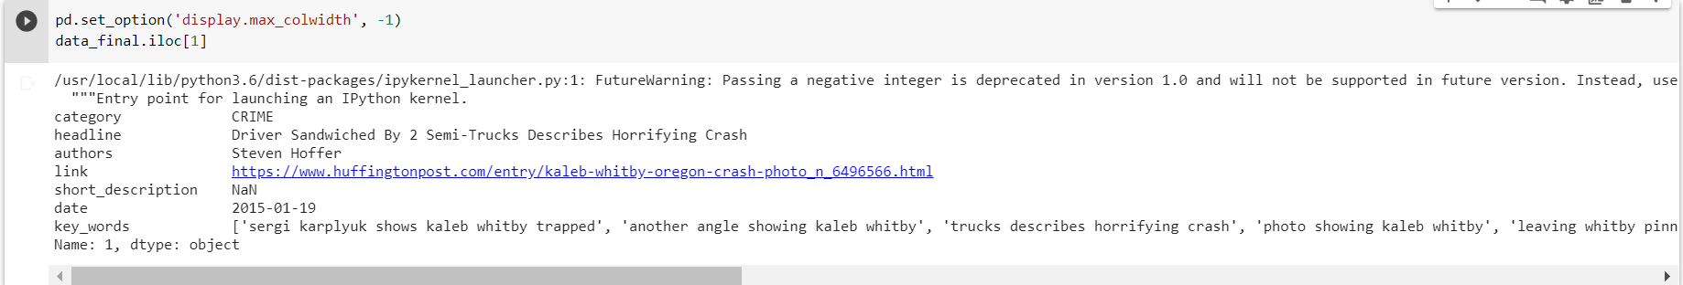
Keywords Extraction
While these techniques are handy only for word extraction, Rake is also good at finding related words and phrases which provide information about semantics and summary of the article.
Rake is known to be a better algorithm in terms of accuracy, performance, simplicity, and efficiency when compared to other algorithms.
We used Rake algorithm for the keywords extraction in each article and stored in the output file for the next steps in the project.

Slide 11
Classification Models
Accessed three classification models for accuracy comparison
Logistic Regression
MultinomialNB
Random Forest Classifier

Slide 12
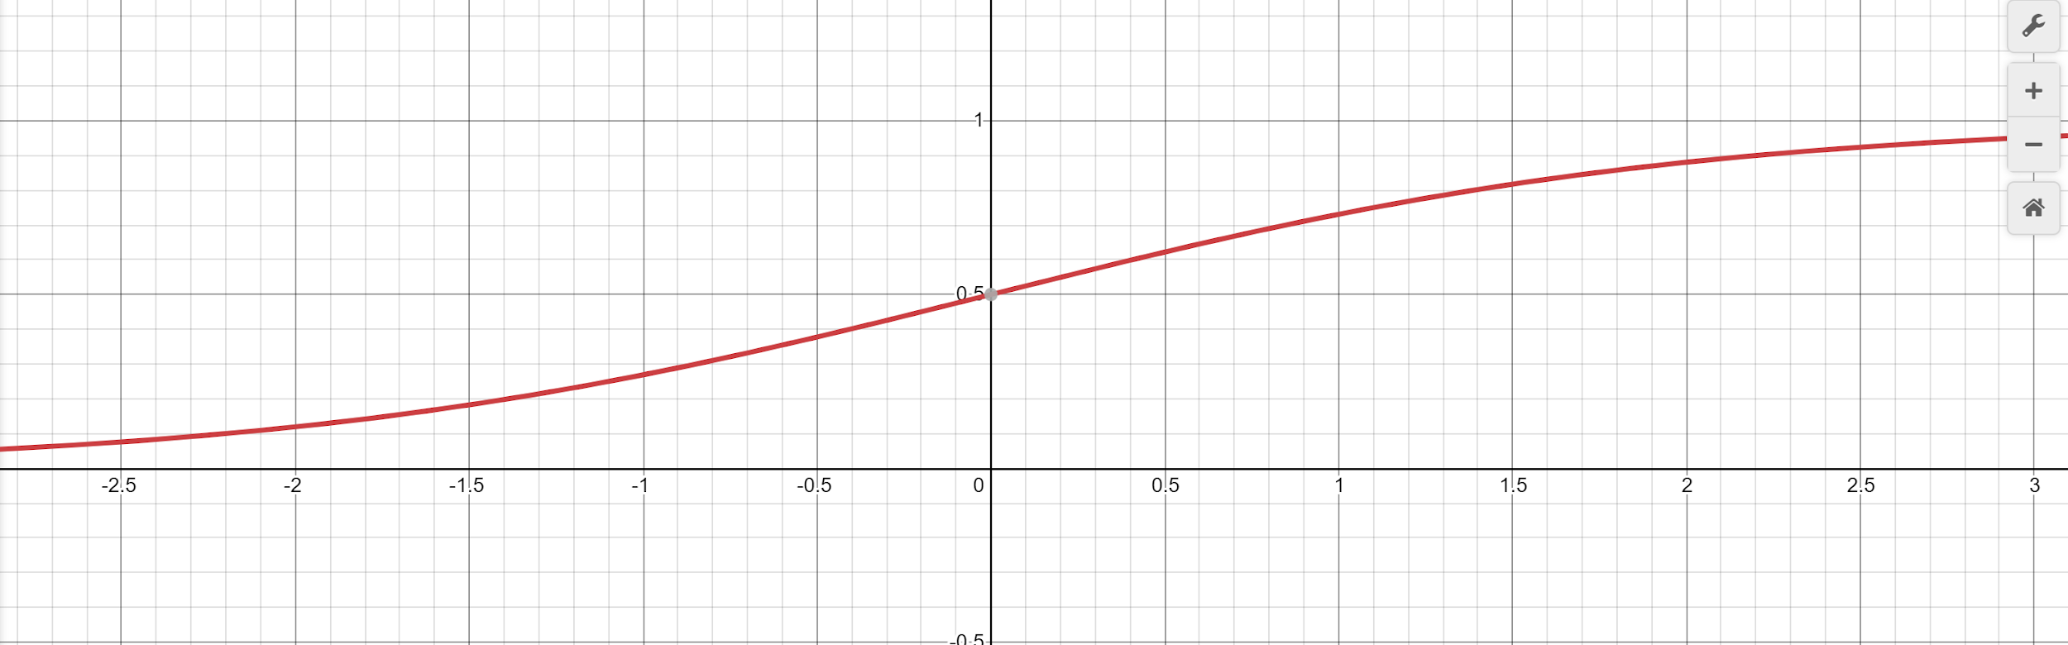
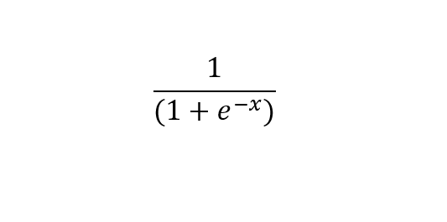
Logistic Regression
Is based on the sigmoid function
Returns 0 and 1

Slide 13
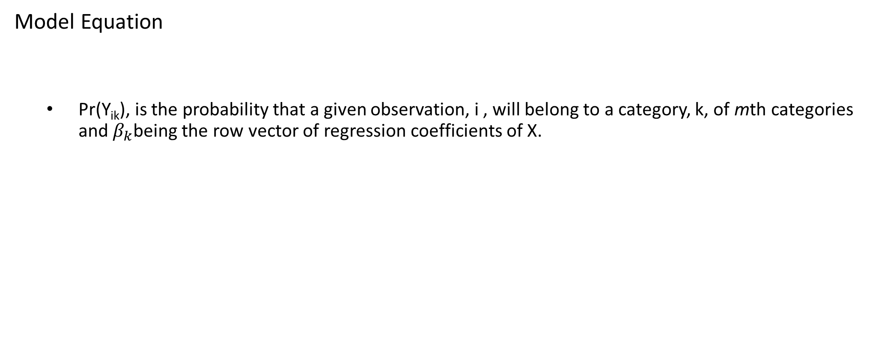

Logistic Regression Model
Notes:
In reagrad to our dataset the following equation is applied

Slide 14
Logistic Regression Model
Advantages
It is efficient and does not require many computational resources.
Highly interpretable
Easy to regularize
Disadvantages
Should not be used if the number of observations are less than the number of features. This can lead to overfitting.
It should only be used to predict discrete functions.

Slide 15
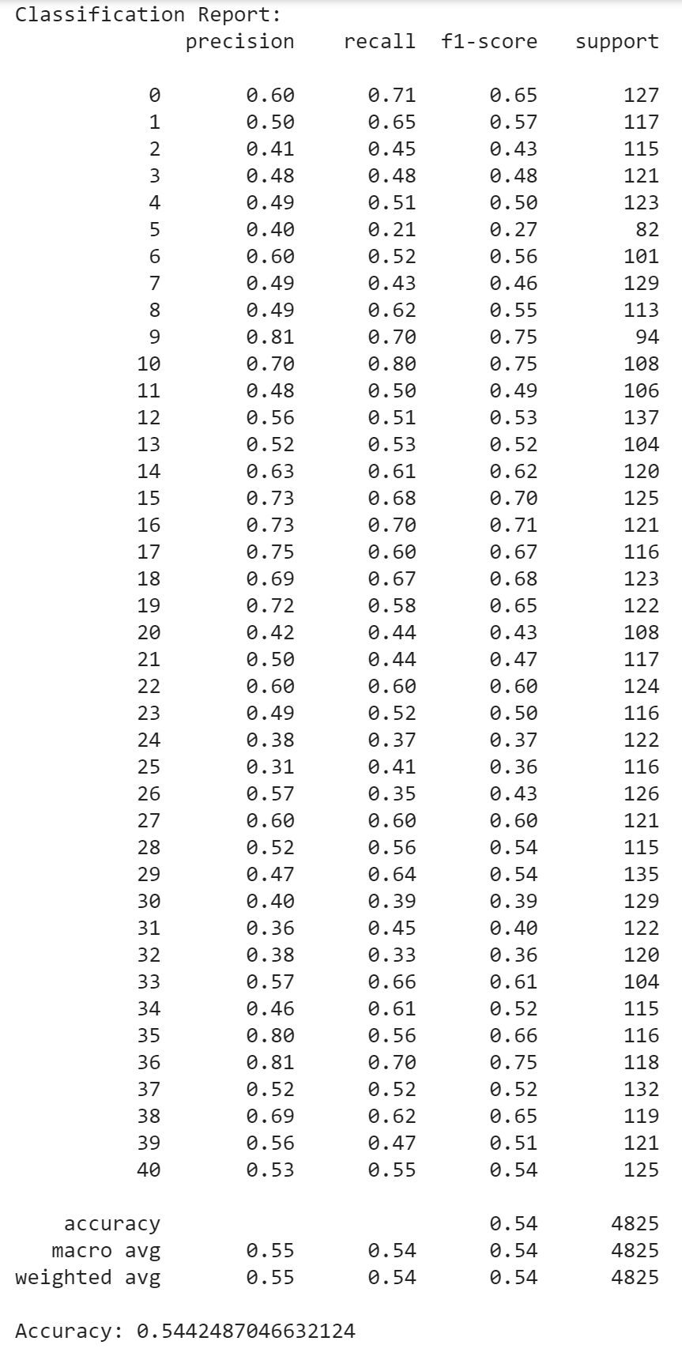
Logistic Regression Model
Results and Classification Report
Accuracy of the model: 0.5442

Slide 16
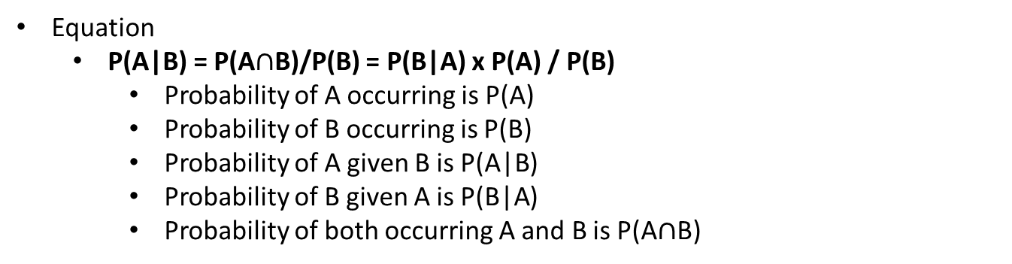
MultinomialNB Model
Based on Baye’s Theorem
Is used to determine the probability of an event occurring, given that the probability of another event has already happened.
Notes:
In reagrad to our dataset MultinoalNM model is applied and the equation is following

Slide 17
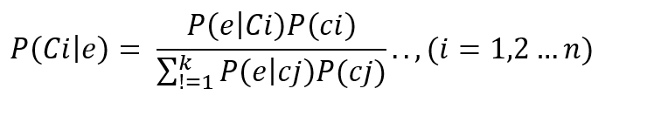
MultinomialNB Model
Model Equation
Ci is the previous probability class
The posterior probability P (Ci|e) is obtained from the Bayesian formula.

Slide 18
MultinomialNB Model
Advantages
It is simple and fast. Also, has low computation cost.
Performs well with small datasets.
Can be used for multiple class perdition scenarios.
Requires less training data.
Best suited for text classification.
Disadvantages
Chances of loss accuracy.
Zero frequency, if the category variable is not seen in training data. The model assigns a zero probability, leading to prediction not being made.

Slide 19
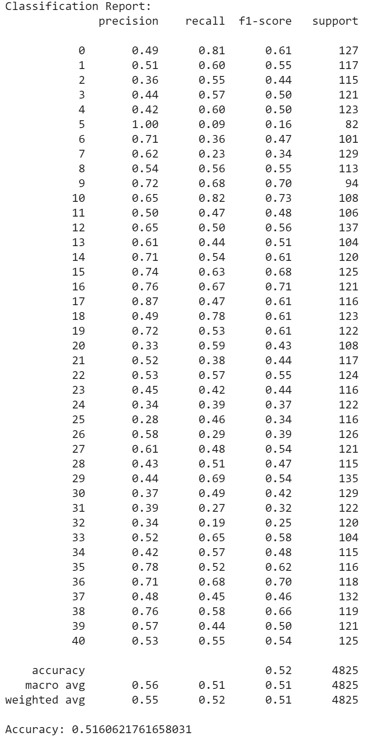
MultinomialNB Model
Results and Classification Report
Accuracy of the model: 0.5161

Slide 20

Random Forest Classifier Model
The model is made up of hundreds or thousands decision trees.
The model uses to concepts:
Random sampling of training data points when building trees,
Random subsets of features considered when splitting nodes.
The Random Forest Classifier is expressed in the following formula:
where -p and -q is the proportion of negative samples, and p+ and q+ is the proportion of positive samples. Entropy of one means the class labels are equally divided, and zero means the sample is completely homogenous.
Advantage
Able to handle non-linear numeric and categorical predictors and outcomes. Where others require numeric inputs and assume linearity. So, it is good for both classification and regression.
Disadvantage
Requires much more computational resources.
Can be difficult to determine significance of each variable

Slide 21
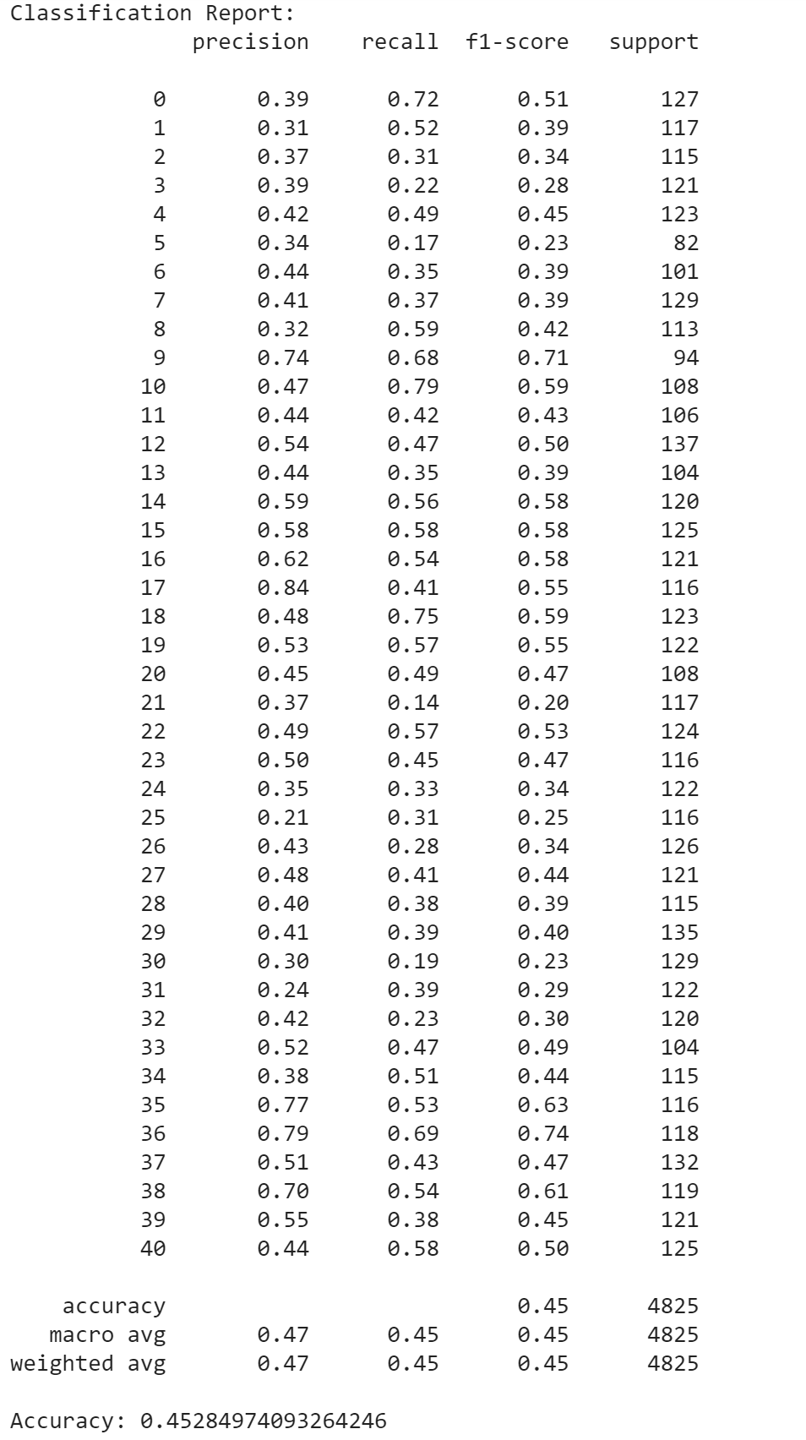
Random Forest Classifier Model
Classification Report and Results
Accuracy of the model: 0.4528

Slide 22
Search Engine
List Relevant Articles at Top of List
Using Key Phrases and Article Features
Term Frequency used in Early Stages to Provide Results
Articles Must be Graded by a Judge for Relevance
Relevance Grades used to Train Model
Model is then used to Provide Results

Slide 23
Search Engine
Query Independent Features
Phrase Count
Word Count
Article Age
Query Dependent Features
Term Frequency
Percent Match of Query
Count of Full Query Occurrence
Inverse Index
RankNet
Normalized Discounted Cumulative Gain

Slide 24
Inverse Index
Quick Reference to Articles from Words
List of All Words in Key Phrases for Every Article
Each Word Linked to Article It Appears
Each Article Lists Positions of Word in Key Phrases
Listing All Documents for Words Appearing in a Query Makes a List of Related Articles
Words from Query with Matching Articles Provides Percent Match
Positions Give Ability to Find Matching Word Order

Slide 25
RankNet
Developed in 2005 by Microsoft Research Lead by Chris Burges
Learning to Rank (LTR) Algorithm
Machine Learning Assigns Score to Documents to Sort
LTR Sorts by Relative Order of Documents
Performs Pairwise Comparisons of Documents
Uses Neural Net to Minimize Incorrect Ordering with Gradient Descent
RankNet Later Evolved into LambdaRank, then LambdaMART Algorithms

Slide 26
RankNet
Pairwise Ordering
Scoring Model
Siamese-like Model using 2 Scoring Models
Input A
Input B
Scoring Model
Difference
Activation

Slide 27


Normalized Discounted Cumulative Gain
Scores Ranking of Results by Relevance Grade
Compares Results Order to Ideal Order
Discounted Cumulative Gain (DCG)
Scores Results Based on Position in List
Results at Top of List Gain Greater Scores
Ideal Discounted Cumulative Gain (IDCG)
Scores Same List as DCG Ordered by Relevance

Slide 28
Search Results
Results:
i | rel | DCG
0 | 3 | 3
1 | 1 | 0.63
2 | 2 | 1
i | rel | DCG
0 | 3 | 3
1 | 2 | 1.26
2 | 1 | 0.5
Ideal:
DCG = 3 + 0.63 + 1 = 4.63
IDCG = 3 + 1.26 + 0.5 = 4.76
NDCG = 4.63 / 4.76 = 0.97
Model is Rebuilt with Relevance Grades of Previous Queries
Each Query Run Gives Better Training to the Model for Next Query
Latest NDCG of First 20 Results:
85% and 57%
Model Continues to Improve with Each Query

Slide 29
References
X. LIANG. “Understand TextRank for Keyword Extraction by Python:A scratch implementation by Python and spaCy to help you understand PageRank and TextRank for Keyword Extraction.” Towards Data Science. https://towardsdatascience.com /textrank-for-keyword-extraction-by-python-c0bae21bcec0#:~:text=TextRank%20is%20an%20algorithm%20based,Extraction%20with%20TextRank%2C%20NER%2C%20etc. (accessed Nov. 29, 2020).
“Keyword Extraction.” MonkeyLearn. https://monkeylearn.com/keyword-extraction/. (accessed Nov. 29, 2020).
M. Y. Helmi Setyawan, R. M. Awangga and S. R. Efendi, "Comparison Of Multinomial Naive Bayes Algorithm And Logistic Regression For Intent Classification In Chatbot," in Intl. Conf. Appl. Engr., IEEE, Batam, Indonesia, Oct. 3-4, 2018, pp. 1-5, doi: 10.1109/INCAE.2018.8579372.
C. Burges, et al., “Learning to rank using gradient descent”, in Proc. 22nd Intl. Conf. Machine Learning, ACM, Bonn, Germany, Aug. 7-11, 2005, pp. 89–96, doi: 10.1145/1102351.1102363.
R. Misra. “News Category Dataset: Identify the type of news based on headlines and short descriptions.” Kaggle. https://www.kaggle.com/ rmisra/news-category-dataset. (accessed Nov. 29, 2020).
L. Richardson. “Beautiful Soup 4.9.0 documentation.” Crummy. https://www.crummy.com/ software/BeautifulSoup/bs4/doc/. (accessed Nov. 29, 2020).
V. B. Sharma. “rake-nltk.” Github. https://csurfer.github.io/rake-nltk/_build/html/index.html. (accessed Nov. 29, 2020).
J. Ravi. (2019). “Mining Data from Text [Online].” Available: https://www.pluralsight.com/ courses/mining-data-text
S. Rose, D. Engel, N. Cramer, and W. Cowley, “Automatic Keyword Extraction from Individual Documents” in Text Mining: Applications and Theory, 1st ed. Chichester, West Sussex, UK: John Wiley & Sons, 2010, ch. 1, pp.1 - 20, doi: 10.1002/9780470689646.ch1

Slide 30
References
F. Pedregosa, et al. “sklearn.feature_extraction.text.TfidfVectorizer.” scikit-learn. https://scikit-learn.org/stable/modules /generated/sklearn.feature_extraction.text.TfidfVectorizer.html. (accessed Nov. 29, 2020).
M. Carpita, M. Sandri, A. Simonetto, P. Zuccolotto, “Football Mining with R”, in Data Mining Applications with R. Brescia, Italy: Academic Press, 2014, ch. 14, pp. 397-433, doi: 10.1016/B978-0-12-411511-8.00015-3.
F. Pedregosa, et al. “sklearn.naive_bayes.MultinomialNB.” scikit-learn. https://scikit-learn.org/stable/modules/generated/sklearn.naive_bayes.MultinomialNB.html (accessed Nov. 29, 2020).
K. Kirasich, T. Smith, B. Sadler, “Random Forest vs Logistic Regression: Binary Classification for Heterogeneous Datasets,” SMU Data Science Review, vol. 1, no. 3, article 9, pp. 1-25, 2018, doi: , https://scholar.smu.edu/datasciencereview/vol1/iss3/9 (accessed Nov. 26, 2020).
M. Stojiljković. “Logistic Regression in Python”. RealPython. https://realpython.com/logistic-regression-python/ (accessed Nov. 26, 2020).
A. Egg. “RankNet: Learning to Rank from Pair-wise data”. Github. https://github.com/eggie5/RankNet (accessed Nov. 26, 2020).
K. Järvelin and J. Kekäläinen, “IR evaluation methods for retrieving highly relevant documents”, in Proc. 23rd ACM SIGIR Conf. R.& D. Info. Retrv., ACM, Athens, Greece, Jan. 24-28, 2000, pp. 41-48, doi: 10.1145/345508.345545.

